Slide 1
OpenGL L1: Setup and “Hello world”
3.1.2018
LUO Ziyun, Room 901, A7, Nanshan Park

Slide 2
What is OpenGL?
OpenGL is a graphic API, but not a platform, more specifically a group
Usually use C++
Use graphics card manufacturers develop the libraries (NVidia, AMD, etc)

Slide 3
Task 1: Creating a window
Create an OpenGL context and application window
Some popular libraries: GLUT, GLFW, SFML, …

Slide 4
GLFW
Download from official website
Pre-built binaries (use 32 bit version) and header files vs. source code
Use CMake to build solution
Build in VS (on Windows), or gcc (on Linux)
Find libraries and headers

Slide 5
Create a new project
Link the libraries to the project
Project Properties -> VC++ Directories -> Include Directories, Library Directories
Project Properties -> Linker -> Input -> Additional Dependencies
glfw3.lib, opengl32.lib
Include <GLFW\glfw3.h>

Slide 6
GLAD
Ease the process of finding functions location
Go to the website, make sure select core, and generate a loader
Get a zip, setup link, import gald.c to your project
#include <glad/glad.h>

Slide 7
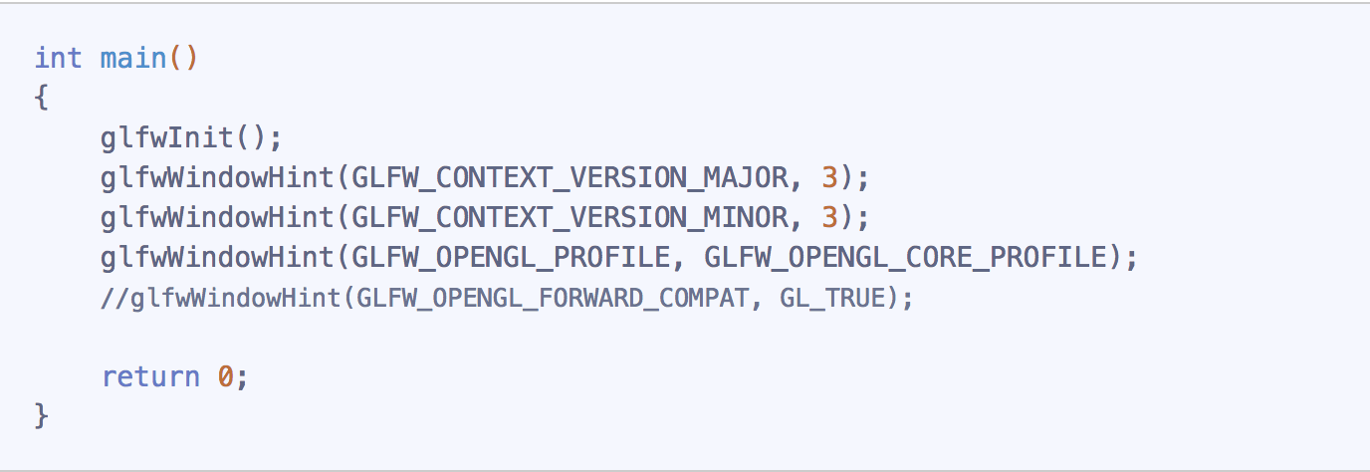
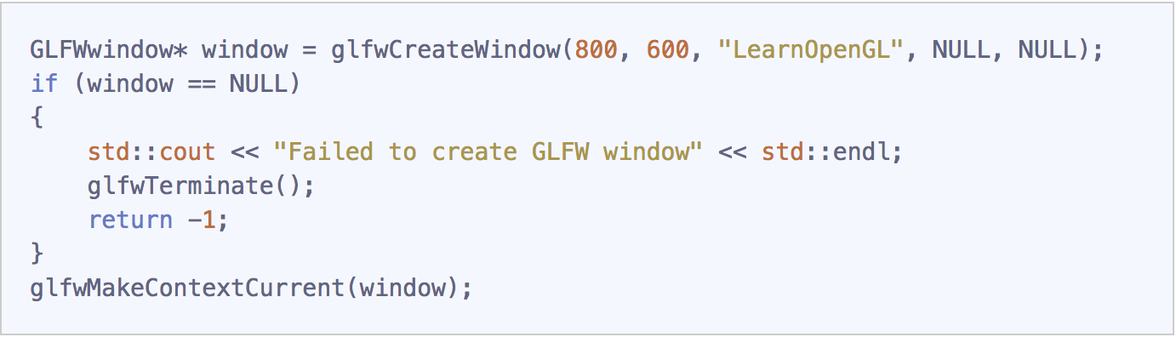
Code

Slide 8
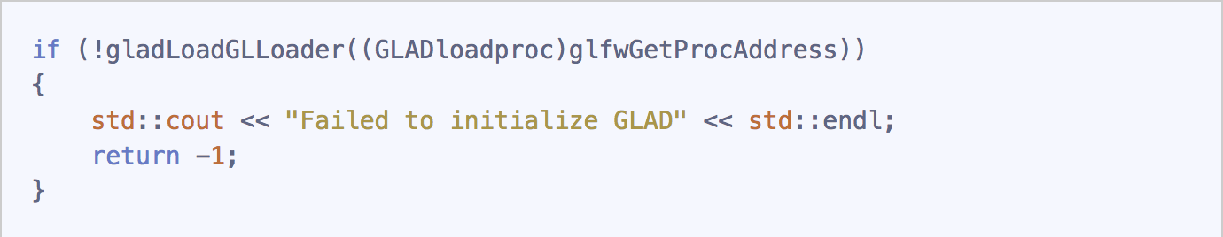
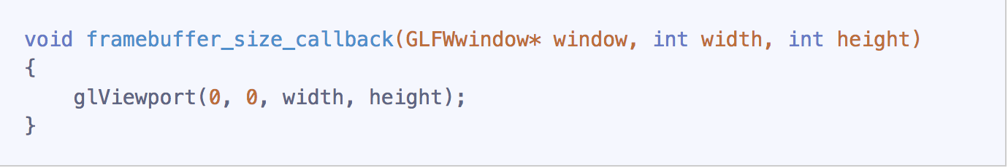
Code
GLAD
Viewport

Slide 9
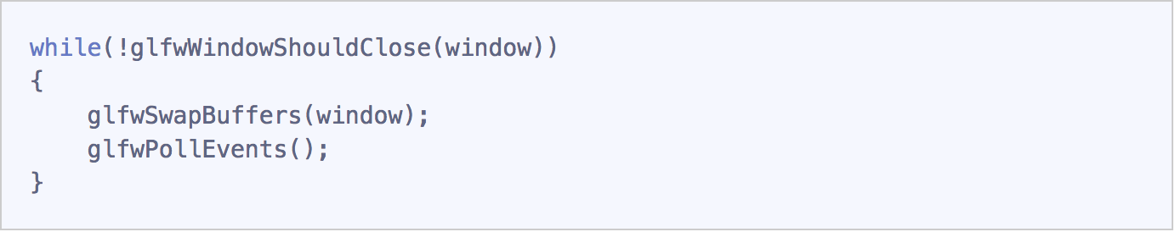
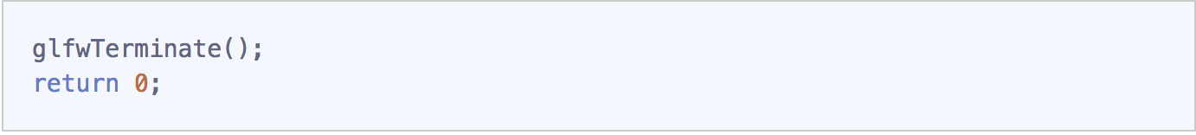
Code
Render loop
Release resource

Slide 10
Assignments
Create a window whose title is your name and student #
Change the window’s background color
write something in the window
Screenshot result with your pc background wallpaper

